Slide 1


Amazon Web Services
Athena

Slide 2

By the end of this lesson, you will be able to:
Introduction to AWS Athena
Athena Architecture
Athena Features
Athena Advantages
Athena Disadvantages
AGENDA

Slide 3
AWS Athena
AWS Athena is a serverless interactive query service that enables normal SQL data analysis in Amazon S3.
Athena is based on Presto, a distributed SQL query engine, and it can query data in Amazon S3 fast using conventional SQL syntax.
There is no infrastructure to handle with Athena, so you can focus on analyzing data at scale. To have more idea of AWS Ethena, let us understand the architecture first.
Amazon Athena is an interactive query service that makes it possible to use normal SQL to evaluate data in Amazon S3. You can also point your AWS Athena to any other database and query it with standard SQL.
An interactive query service that makes it easy to analyze data directly in Amazon S3 and other data sources using SQL.

Slide 4
AWS Athena Architecture
Apache Presto, an open-source distributed SQL query engine, serves as the foundation for Athena.
When a query is submitted by a user, Athena generates a query plan and sends it to Presto for execution. Presto then distributes the query over numerous cluster nodes for parallel processing.
The results are subsequently compiled and presented to the user. Athena stores table and partition metadata in a controlled Hive metastore.
When a query is run, Athena gets the metadata from the metastore to establish the data’s location and format.
Athena also interfaces with AWS Glue, a fully managed extract, transform, and load (ETL) service, allowing customers to create and manage data catalogs and ETL processes. Furthermore, we will go through the various components of AWS Athena.

Slide 5
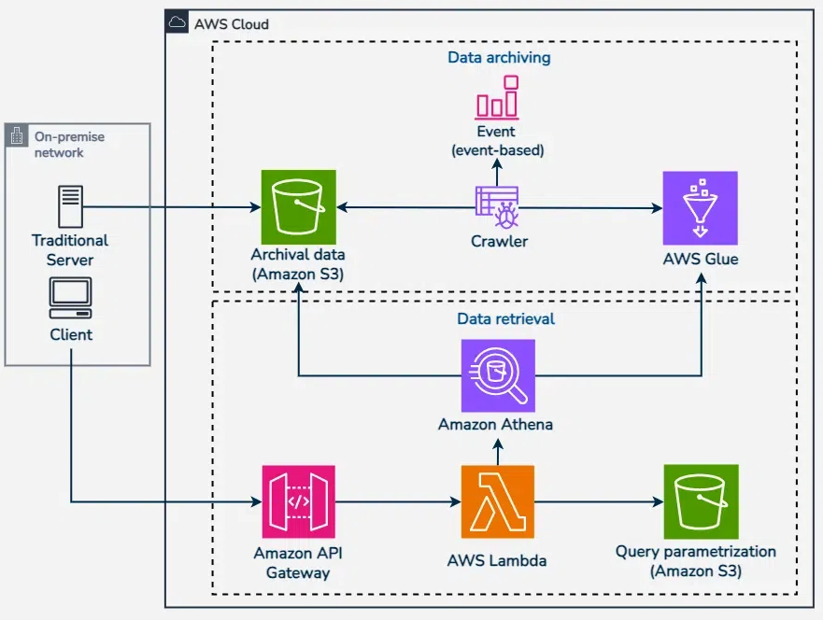
AWS Athena Architecture

Slide 6
AWS Athena Features
Serverless architecture: Athena is a fully-managed service that does not require any infrastructure setup, management, or scaling.
Standard SQL support: Since the Athena supports of ANSI SQL, users can easily query the data in S3 through using their existing SQL knowledge and tools.
Connection with the AWS ecosystem: Athena interfaces with other AWS services such as Amazon S3, AWS Glue, and AWS Lambda, enabling customers to import and convert data from a variety of sources.
Cost-effective pricing model: Athena’s pricing approach is cost-effective since it costs customers based on the amount of data scanned by their queries, making it ideal for ad-hoc and exploratory queries.
Integration with BI tools: Athena provides connectivity with major business intelligence tools like as Tableau, Power BI, and Amazon QuickSight, allowing users to build visualizations and reports.

Slide 7
AWS Athena Advantages
No infrastructure setup: Athena is a serverless service that eliminates the need for users to set up and manage infrastructure, making data querying easier and faster.
Cost-effective: Athena charges customers solely for the quantity of data scanned by their searches, making it an affordable solution for ad hoc and exploratory queries.
Scalability: Athena is a fully-managed service that can automatically scale to accommodate massive amounts of data and queries.
SQL support: Since Athena supports ANSI SQL, users can query data in S3 using their existing SQL knowledge and tools.

Slide 8
AWS Athena Disadvantages
Restricted query performance: The volume of data scanned and the intricacy of the query can limit Athena’s speed, resulting in lengthier query times.
No real-time querying: Because Athena is intended for batch processing, it may not be ideal for real-time querying.
Limited data types: In comparison to other database systems, Athena only supports a restricted selection of data types.

Slide 9
QUIZ Time!!
What is AWS Athena primarily used for?
Data warehousing
Running SQL queries on data stored in S3
ETL processes
Machine learning model training
Notes:
It’s Quiz Time!
Please read the question carefully and check all the options given. Pause the video for 10 seconds and answer the question.
Which of the following applications use AI?
Is it the gram (or the instagram)?
Or is it YouTube?
Is it the net banking application of your bank?
or is it the Anti-virus software installed in your computer or phone?
Which one of these leverage AI?

Slide 10

QUIZ Time!!
What is AWS Athena primarily used for?
Data warehousing
Running SQL queries on data stored in S3
ETL processes
Machine learning model training
Notes:
It’s Quiz Time!
Please read the question carefully and check all the options given. Pause the video for 10 seconds and answer the question.
Which of the following applications use AI?
Is it the gram (or the instagram)?
Or is it YouTube?
Is it the net banking application of your bank?
or is it the Anti-virus software installed in your computer or phone?
Which one of these leverage AI?

Slide 11
QUIZ Time!!
Which of the following is a feature of AWS Athena?
Requires setting up servers and managing infrastructure
Charges based on the amount of data scanned by queries
Only supports JSON data formats
Can only query data stored in Amazon RDS
Notes:
It’s Quiz Time!
Please read the question carefully and check all the options given. Pause the video for 10 seconds and answer the question.
Which of the following applications use AI?
Is it the gram (or the instagram)?
Or is it YouTube?
Is it the net banking application of your bank?
or is it the Anti-virus software installed in your computer or phone?
Which one of these leverage AI?

Slide 12
QUIZ Time!!
Which of the following is a feature of AWS Athena?
Requires setting up servers and managing infrastructure
Charges based on the amount of data scanned by queries
Only supports JSON data formats
Can only query data stored in Amazon RDS
Notes:
It’s Quiz Time!
Please read the question carefully and check all the options given. Pause the video for 10 seconds and answer the question.
Which of the following applications use AI?
Is it the gram (or the instagram)?
Or is it YouTube?
Is it the net banking application of your bank?
or is it the Anti-virus software installed in your computer or phone?
Which one of these leverage AI?

Slide 13
QUIZ Time!!
Which SQL engine does AWS Athena use?
PostgreSQL
MySQL
Presto
SQLite
Notes:
It’s Quiz Time!
Please read the question carefully and check all the options given. Pause the video for 10 seconds and answer the question.
Which of the following applications use AI?
Is it the gram (or the instagram)?
Or is it YouTube?
Is it the net banking application of your bank?
or is it the Anti-virus software installed in your computer or phone?
Which one of these leverage AI?

Slide 14
QUIZ Time!!
Which SQL engine does AWS Athena use?
PostgreSQL
MySQL
Presto
SQLite
Notes:
It’s Quiz Time!
Please read the question carefully and check all the options given. Pause the video for 10 seconds and answer the question.
Which of the following applications use AI?
Is it the gram (or the instagram)?
Or is it YouTube?
Is it the net banking application of your bank?
or is it the Anti-virus software installed in your computer or phone?
Which one of these leverage AI?

Slide 15
QUIZ Time!!
How can you reduce the amount of data scanned by AWS Athena to save costs?
Use larger files for storage
Use the SELECT * statement in queries
Partition the data
Store the data in multiple S3 buckets
Notes:
It’s Quiz Time!
Please read the question carefully and check all the options given. Pause the video for 10 seconds and answer the question.
Which of the following applications use AI?
Is it the gram (or the instagram)?
Or is it YouTube?
Is it the net banking application of your bank?
or is it the Anti-virus software installed in your computer or phone?
Which one of these leverage AI?

Slide 16
QUIZ Time!!
How can you reduce the amount of data scanned by AWS Athena to save costs?
Use larger files for storage
Use the SELECT * statement in queries
Partition the data
Store the data in multiple S3 buckets
Notes:
It’s Quiz Time!
Please read the question carefully and check all the options given. Pause the video for 10 seconds and answer the question.
Which of the following applications use AI?
Is it the gram (or the instagram)?
Or is it YouTube?
Is it the net banking application of your bank?
or is it the Anti-virus software installed in your computer or phone?
Which one of these leverage AI?

Slide 17
QUIZ Time!!
Which AWS service can be integrated with Athena to enable easy visualization of query results?
Amazon Redshift
Amazon QuickSight
Amazon EMR
AWS Glue
Notes:
It’s Quiz Time!
Please read the question carefully and check all the options given. Pause the video for 10 seconds and answer the question.
Which of the following applications use AI?
Is it the gram (or the instagram)?
Or is it YouTube?
Is it the net banking application of your bank?
or is it the Anti-virus software installed in your computer or phone?
Which one of these leverage AI?

Slide 18
QUIZ Time!!
Which AWS service can be integrated with Athena to enable easy visualization of query results?
Amazon Redshift
Amazon QuickSight
Amazon EMR
AWS Glue
Notes:
It’s Quiz Time!
Please read the question carefully and check all the options given. Pause the video for 10 seconds and answer the question.
Which of the following applications use AI?
Is it the gram (or the instagram)?
Or is it YouTube?
Is it the net banking application of your bank?
or is it the Anti-virus software installed in your computer or phone?
Which one of these leverage AI?

Slide 19
Key takeaways
Security , Compliance & Monitoring
Data Management and Analytics
Source & Target query engine
1
3
5
7
2
4
6
Easy-to-Use Database Query
Cost-Effective Replica Query Engine
High Availability and Durability
Homogenous & Heterogeneous database query

Slide 20
THANK YOU

